Slide 1
FitBits Tracker Data Analysis
By : Samyak Jain
Last Updated : 6th September 2023

Slide 2
Table of Content
Objective of the Study
Some Interesting Findings
Conclusion & Recommendations
Citations

Slide 3
Objectives of the Study

Slide 4
To calculate the time taken by each subject to sleep (difference b/w their total time in bed and minutes slept)
How different lifestyles and sedentary levels affect sleep.

Slide 5
Findings of the Study

Slide 6
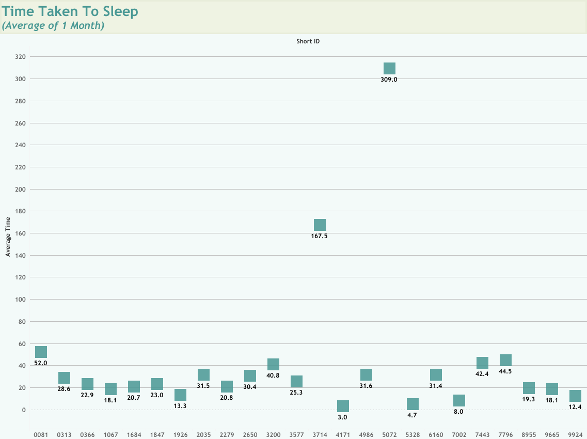
1. Total Time Taken to Sleep
I conducted this study to deduce how long people must lay in the bed to sleep, so that we could remind them that much before their bedtime to go to the bed, so that they can meet their bedtime goals.
Calculated avg time taken to sleep by deducting total minutes asleep from total time spent in bed and then taking the average for each user (over a period of around 1 month).
We can record this data and notify the users according to their stats to head to bed on time, to ensure better sleep quality adequate duration, & better time management.

Slide 7
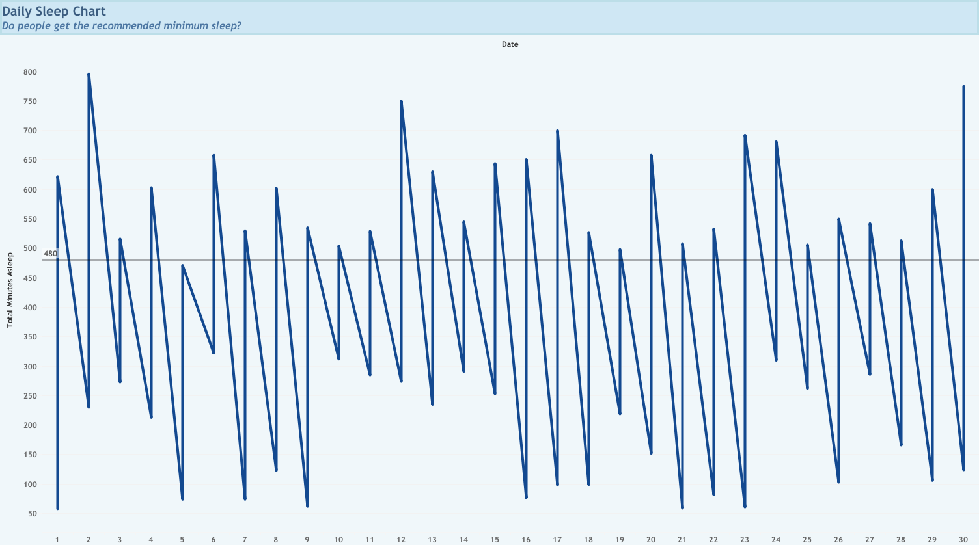
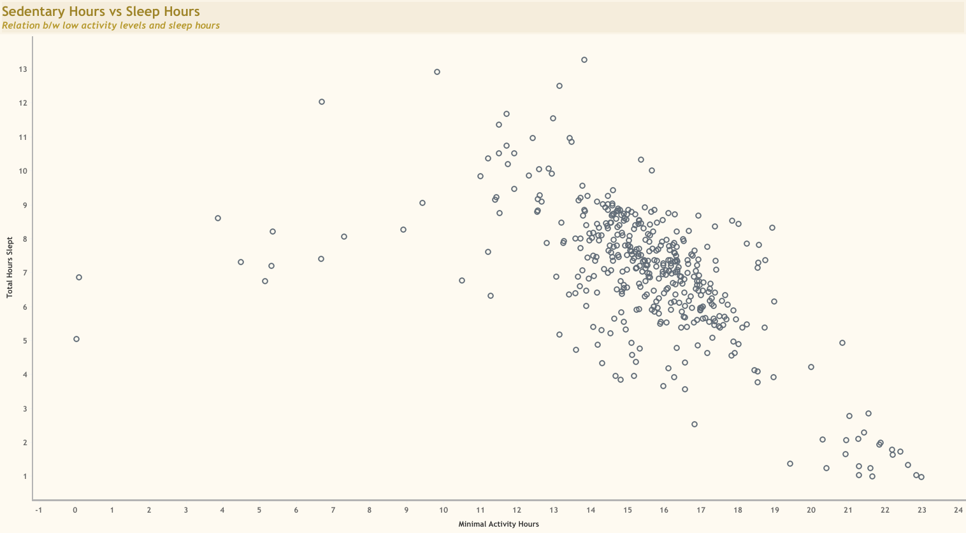
2. Sedentary Hours vs Sleep Hours
In the Daily Sleep Chart, we can see that mostly people are not getting the recommended sleep of 8 hours per day.
In the second chart, There is an obvious negative relation between the number of sedentary hours and the number of hours slept.
This means the lesser a person stays active during the day, the less they sleep, and sleep is one of the most important factors to stay healthy.

Slide 8
Conclusion & Recommendations

Slide 9
Conclusion & Recommendations
People can be reminded to go to bed after calculating their average time taken to sleep, so that they can plan better and manage their time and sleep.
Most people do not get adequate sleep of 8 hours per day, so we can make the users more aware of it by showing sleep stats and a negative sign if they are below the recommend sleep durations.
We can remind our users to stay more active during the day which will help their body be more fit through physical activities (e.g., some sport or gym) but also by getting good sleep.
1
2
3

Slide 10
Citations

Slide 11
Used the publicly available dataset FitBit Fitness Tracker Data, made available by Möbius on kaggle.com.
This Kaggle data set contains personal fitness trackers from thirty Fitbit users. Thirty eligible Fitbit users consented to the submission of personal tracker data, including minute-level output for physical activity, heart rate, and sleep monitoring. It includes information about daily activity, steps, and heart rate that can be used to explore users’ habits.

Slide 12
Thank you

